Slide 1
Ch. 15 Acids and Bases
7th Science

Slide 2
ACID | BASE
Citrus fruit (ascorbic acid C₆H₈O₆) Vinegar (acetic acid C₂H₄O₂) Toilet-bowl cleaners (HCl) Soda (carbonic acid H₂CO₃) Sour Turns pH paper red pH < 7 | Baking soda (sodium bicarbonate NaHCO3) Ashes (alkaline) Potassium carbonate K₂CO₃ Soap (react base with animal oil) so is basic Drain cleaner sodium hydroxide NaOH Bitter Slippery (turns your oils to soap!) pH > 7

Slide 3
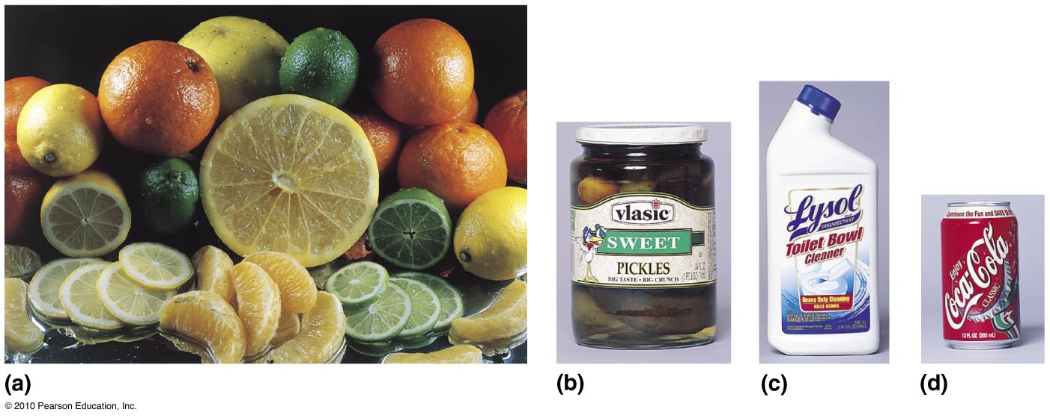
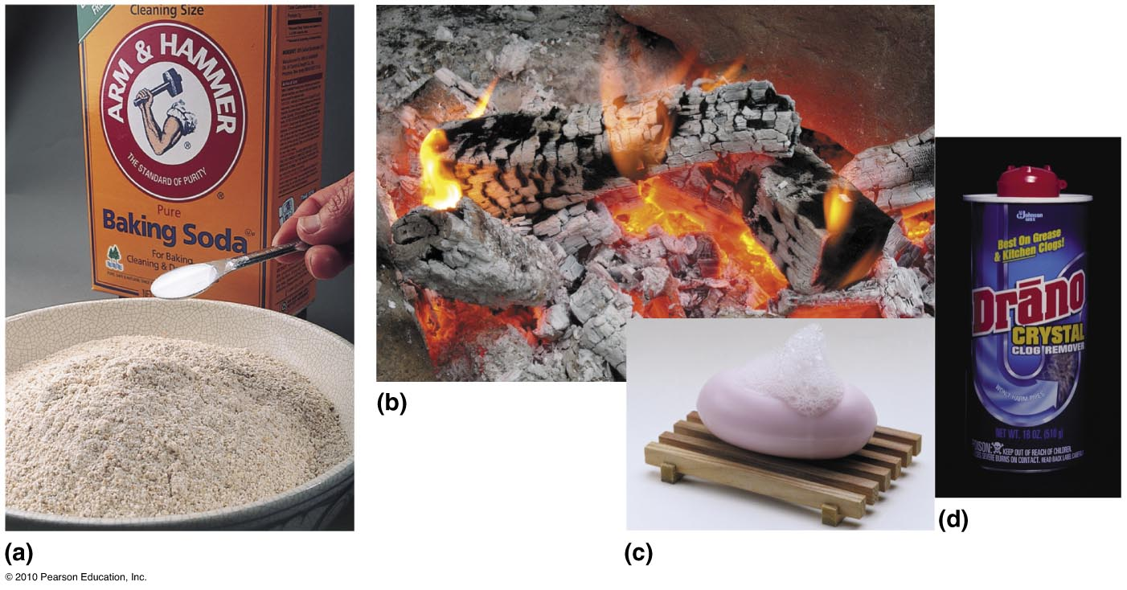

Slide 4
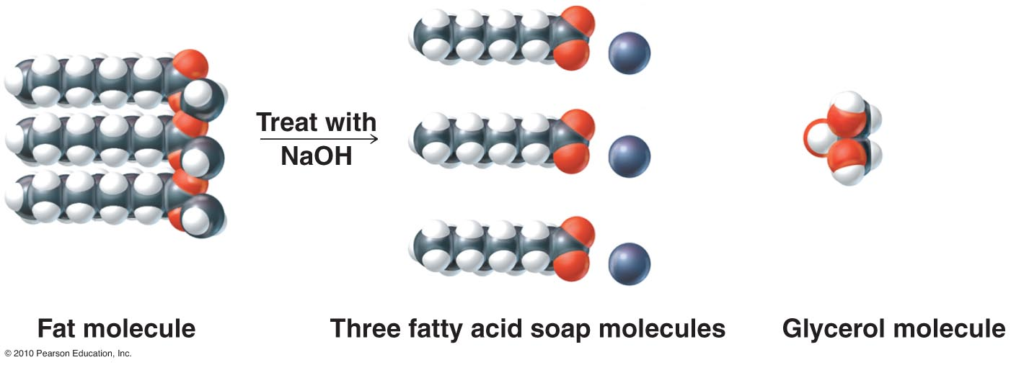

Slide 5
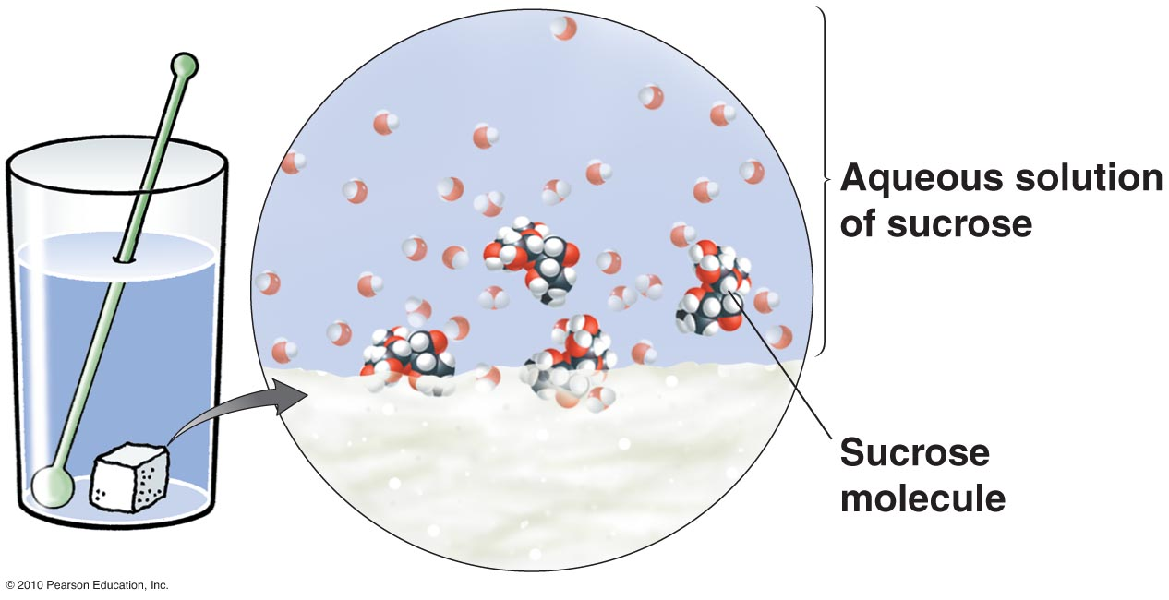
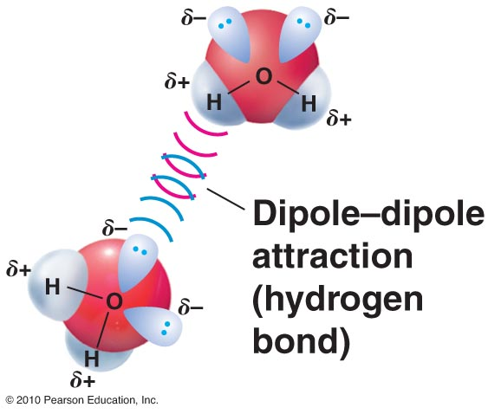
18.3 Solutions
Bonds between molecules
“sticky” = polar
Hydrogen bond
Sugar water solution

Slide 6
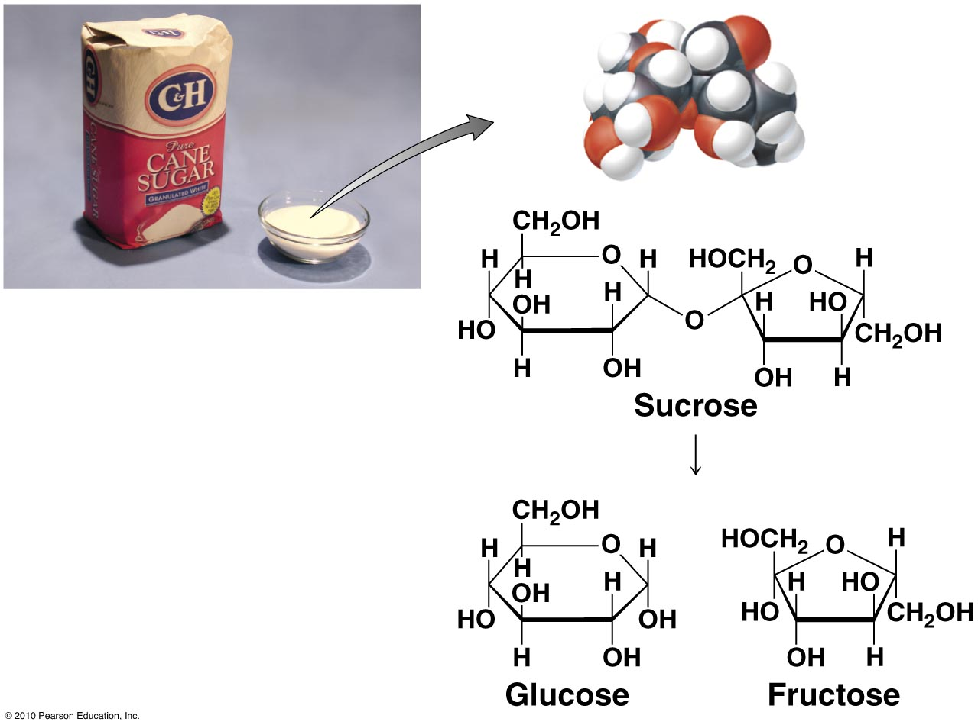
Side Note: Sucrose (Pg. 460)

Slide 7
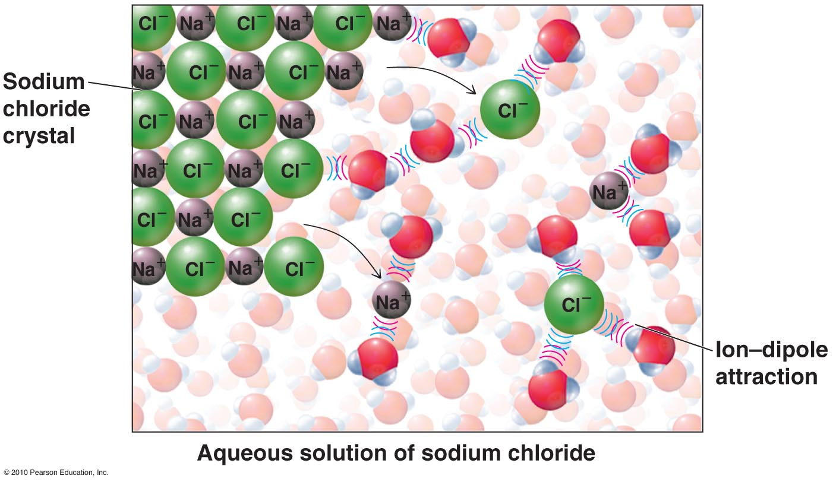
18.3 Making Solutions: Saltwater
Is this ion-dipole, dipole-dipole, or dipole-induced dipole?
Ion-dipole
Does dissolving table salt dissolve the ionic bonds? Yes.

Slide 8
Electrolyte or not? (covalent? Ionic?)

Slide 9
electrolyte

Slide 10
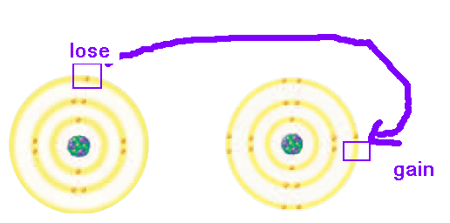
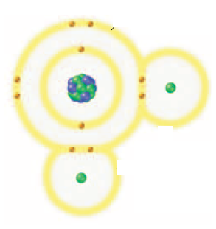
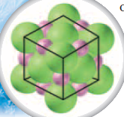
15.1 Compounds: Fill in the chart
Compound names:
Ionic compound
Molecule
Covalent compound
Examples
Nonmetal-nonmetal
Metal-metal
Table salt
Water
Tight valence electrons
Structure
Cotton
protein
Crystal lattice
Brittle
Non-crystalline (except diamond, sugar)
Pattern shifts → like charges repel
Organic compounds
DNA

Slide 11
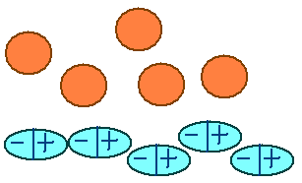
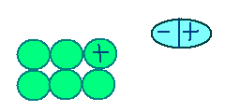
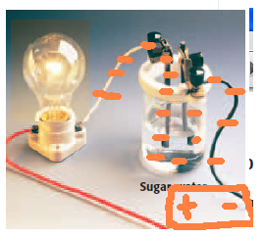
Compounds: Fill in The Chart
Melting Point
Low
High
Loose bonds between molecules easily shaken apart
Strong bonds between compounds need more energy to loosen
Solubility in water
Low
High
Electrical conductivity
Good
Bad
No ions
Ions are charged

Slide 12
Something to Add…

Slide 13
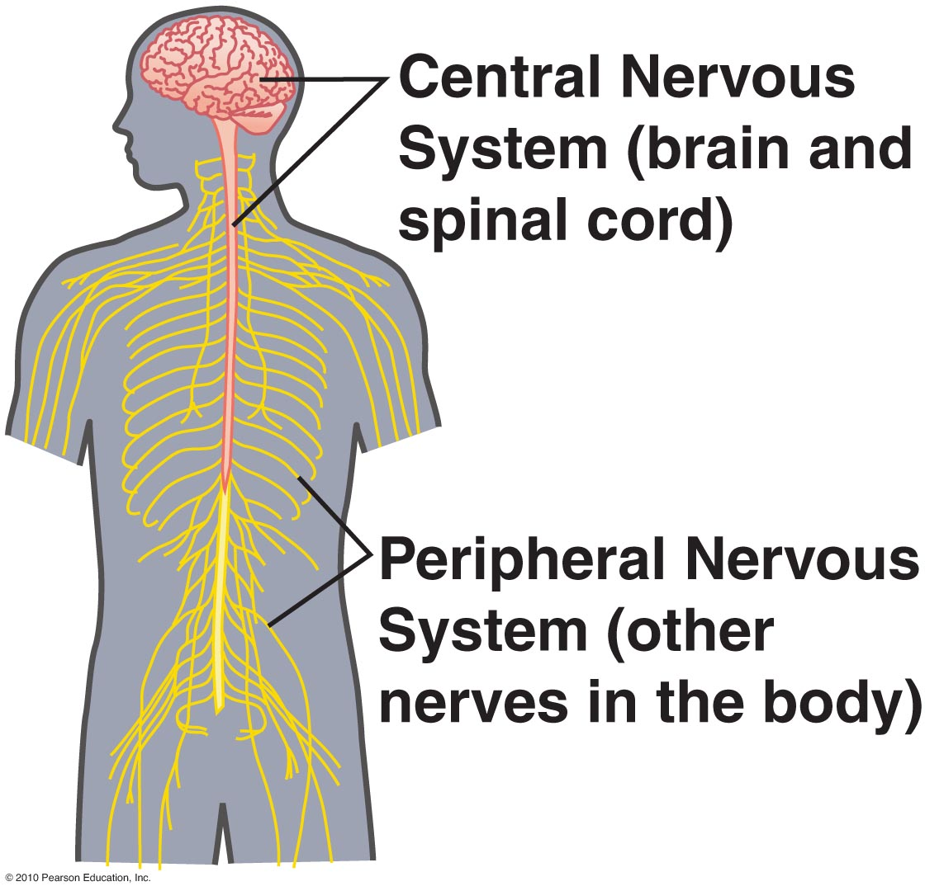
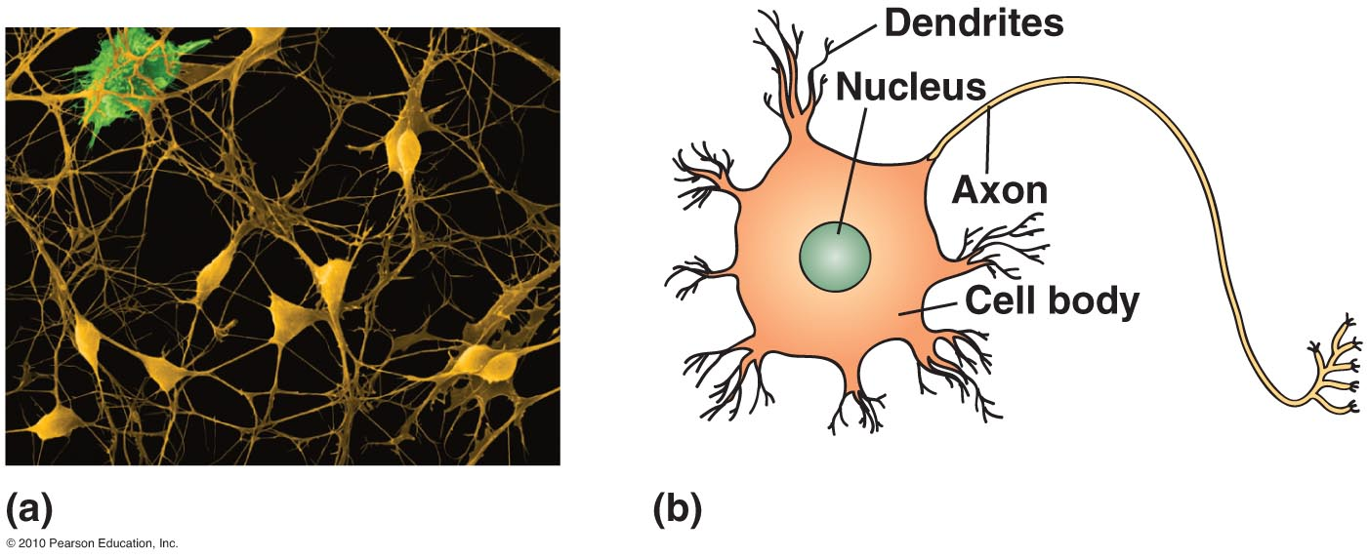
Stress Response – Nervous System

Slide 14
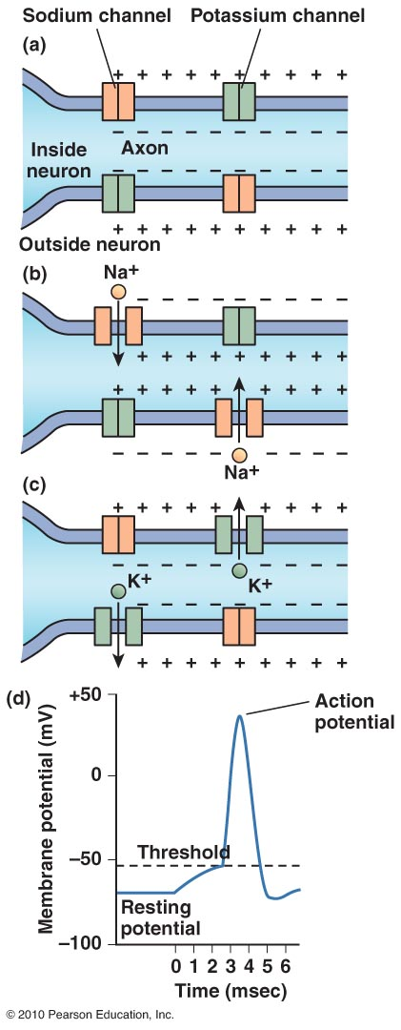
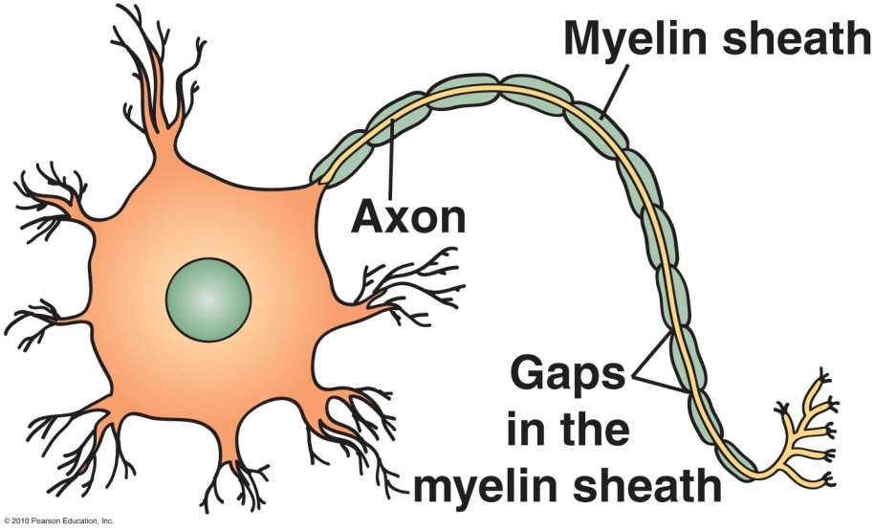
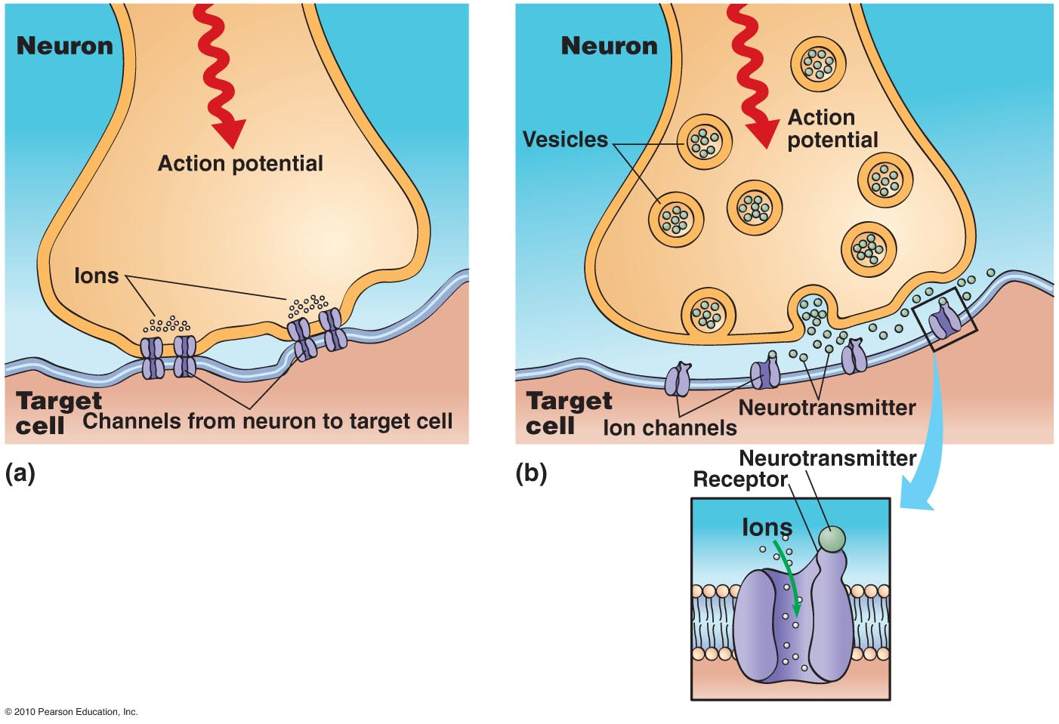
Stress Response – Nervous System

Slide 15
Acid- Base Reaction: Bronsted – Lowry definition

Slide 16
15.2 Fill in Pg. 4 (Acids – Base Venn Diagram)

Slide 17
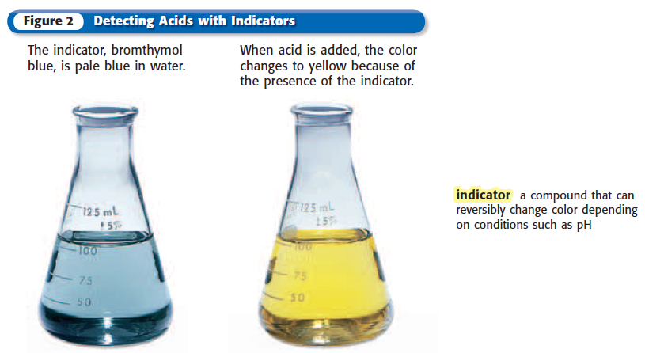
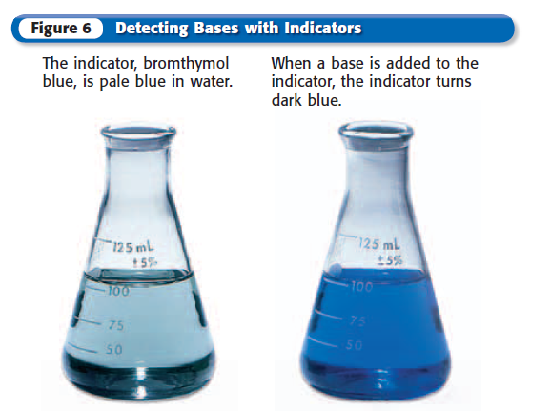
15.2 Fill in Pg. 4 (Acids – Base Venn Diagram)
Bromthymol blue is a pH indicator

Slide 18
15.3 Acids ~ hydronium ion Base ~ Hydroxide ion
Pg. 5
When dissolved in water, acid increases ________________ ion concentration.
Show how hydrochloric acid in water makes ions.
What is a “strong acid”?
Strong acid examples:
Weak acid examples:

Slide 19
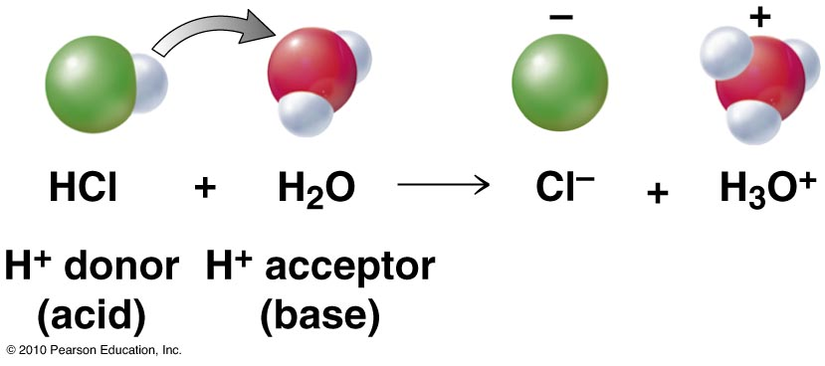
Acid- Base Reaction: Bronsted – Lowry definition
Draw the Bohr models. Show how the proton transfers. Show how the hydronium ion appears.

Slide 20
15.3 Acids ~ hydronium ion Base ~ Hydroxide ion
Pg. 5
When dissolved in water, base increases ________________ ion concentration.
Show how sodium hydroxide decomposes into ions.
Save room to show how ammonia makes OH- in water.
What is a “strong base”?
Strong base examples:
Weak base examples:

Slide 21
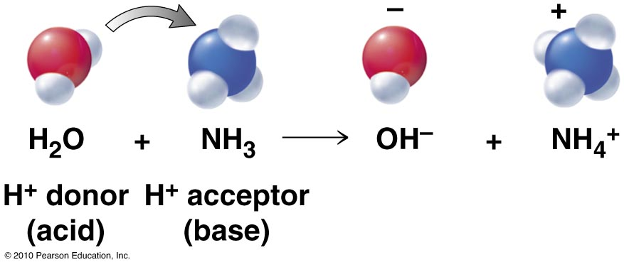
Acid- Base Reaction: Bronsted – Lowry definition
Draw the Bohr models. Show how the proton transfers. Show how the hydronium ion appears.

Slide 22
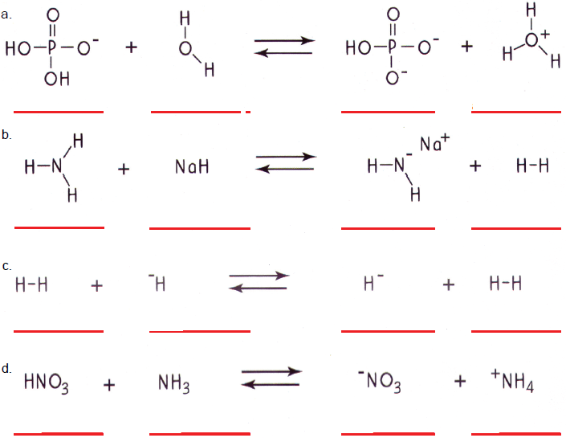

Slide 23
15.3 Neutralization Reaction
Idea

Slide 24
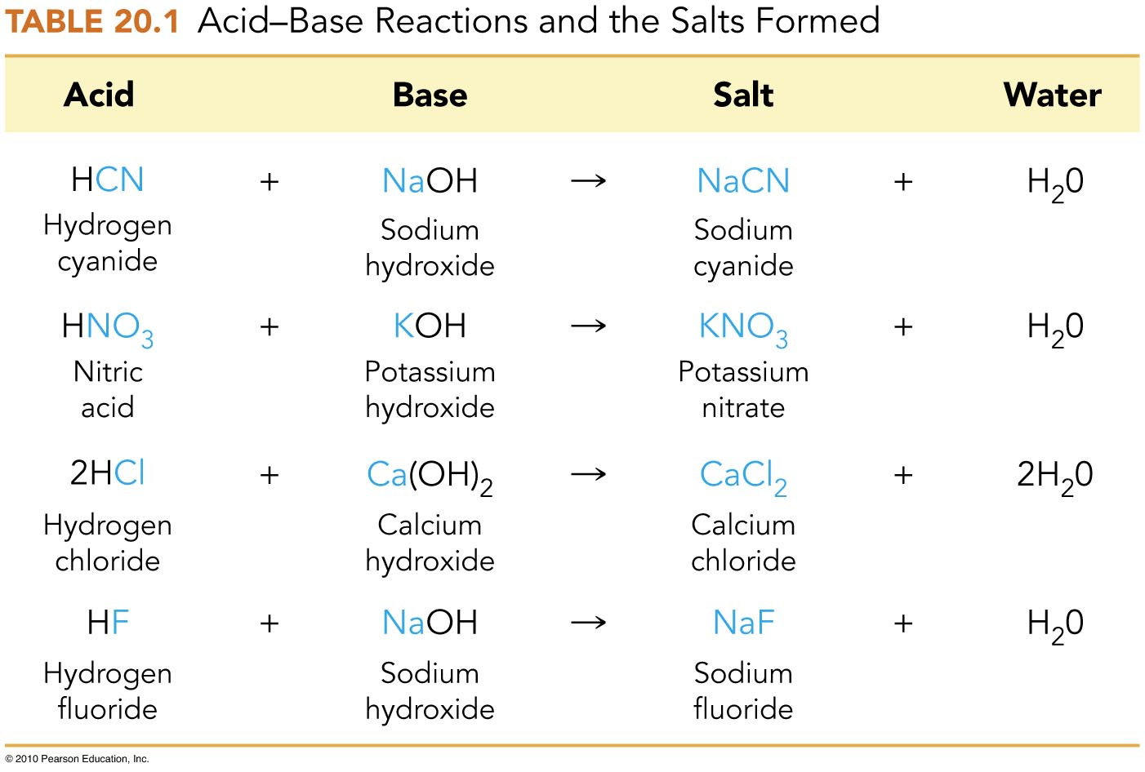
Acid- Base Reaction (neutralization)
Metal from base switches with hydrogen from acid
Poison
Saltpeter
De-ice
Toothpaste

Slide 25
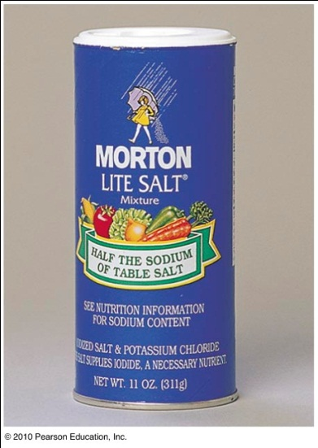
Acid- Base Reaction: Bronsted – Lowry definition
Pg. 410
Hydrogen chloride + sodium hydroxide → table salt + water
Hydrogen chloride + potassium hydroxide →
potassium chloride + water
Sodium (Na) and potassium (K) are needed for our signals to flow along nervous system

Slide 26
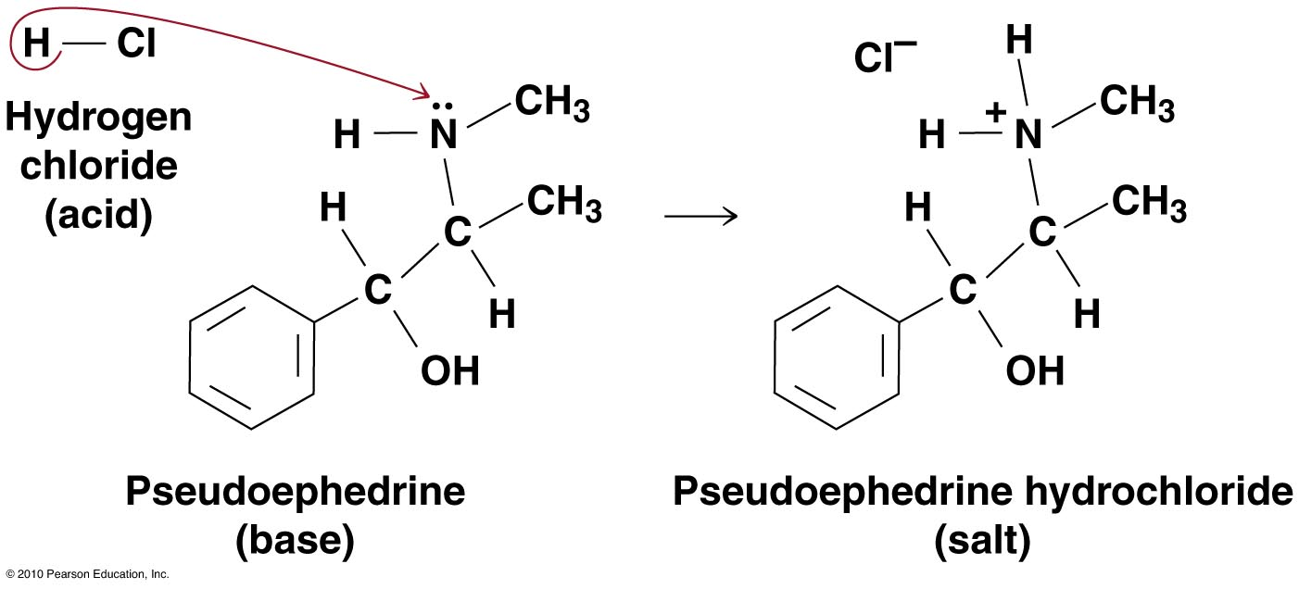
Medicine: Water-Soluble salt Can be ABSORBED

Slide 27
Neutralization
Is it a chemical or physical change?

Slide 28
15.3 Neutralization Reaction (Pg. 6)

Slide 29
Strength of Acid and Base
Strong acid:
almost all donates H⁺
Split into monmetal + H⁺
and forms H₃O⁺ (hydronium ion)
Strong base:
almost all takes H⁺
and forms OH⁻⁻ (hydroxide ion)
or splits into metal + OH⁻
Corrosive:
Strong acid in medium concentration
(not very corrosive if low concentration)
Weak acid in high concentration

Slide 30
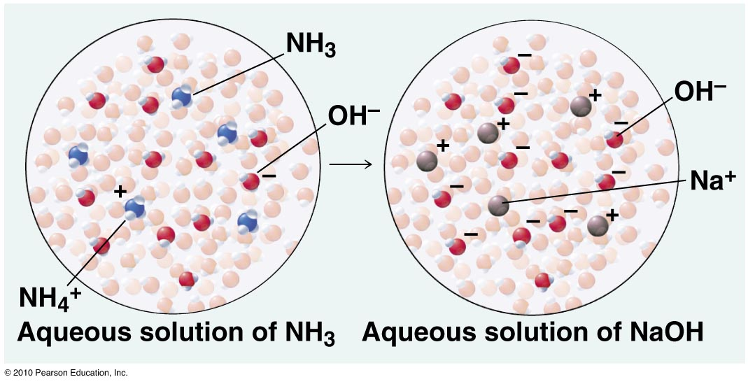
Strength of Acid and Base
In these aqueous solutions, which is the stronger base?

Slide 31
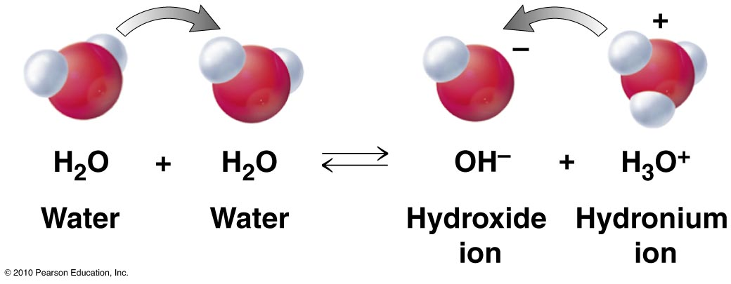
15.3 pH
Both ways reaction: Acid or base?
Do water molecules react with one another?
Is water neutral? Why?

Slide 32
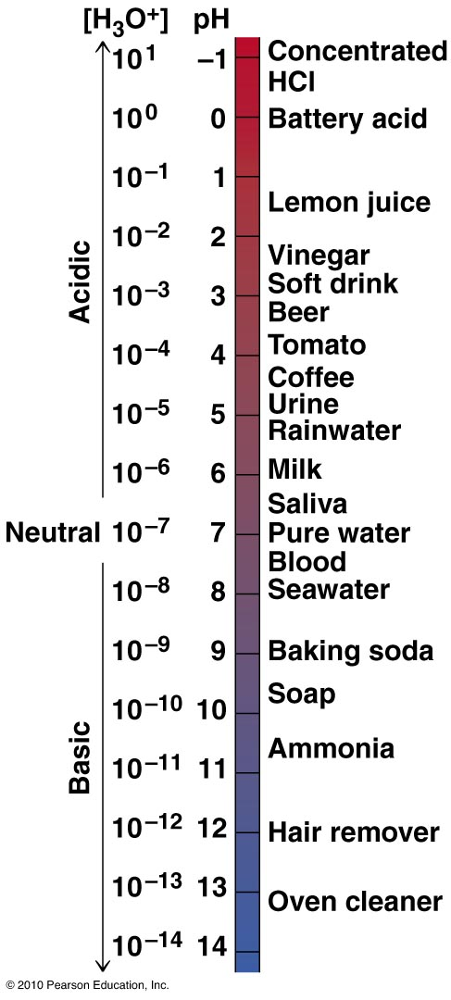
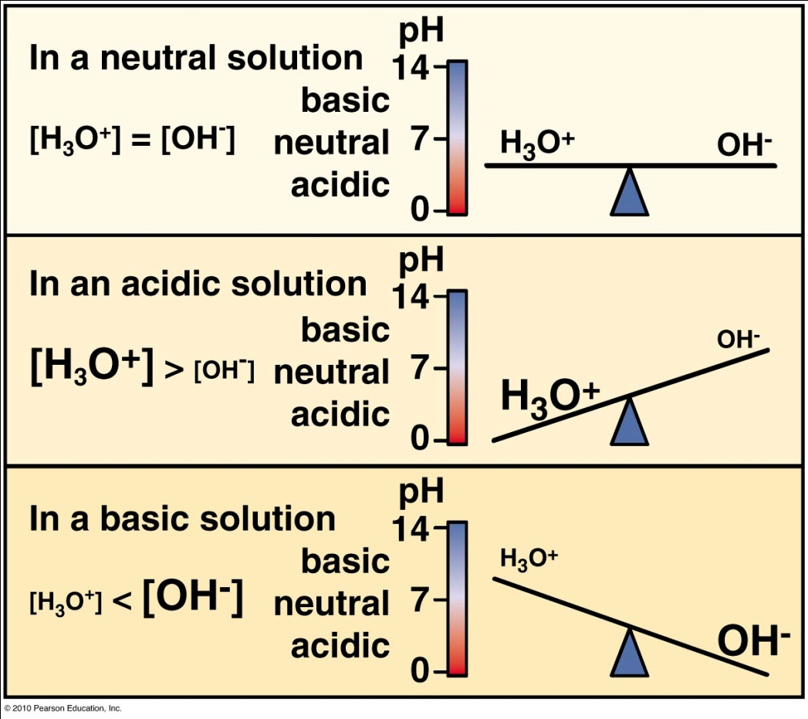
15.3 pH
Acidic solution
pH < 7
Basic solution
pH > 7

Slide 33
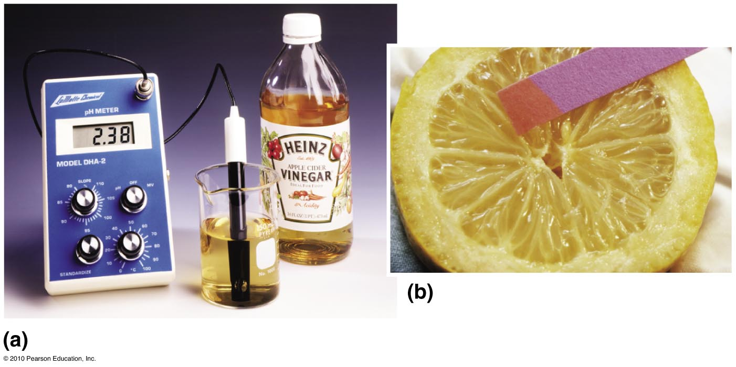
15.3 pH
pH is used to describe acidity
pH = -log[H₃O⁺]
(molarity)
pOH = -log[OH⁻]
[H⁺] [OH⁻]=10⁻¹⁴M
pH + pOH = 14

Slide 34
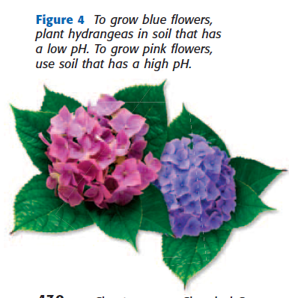
15.3 pH
pH and the Environment
Hydrangeas
Pink (high pH) blue (low pH)

Slide 35
DEMO: Making Salt
HCl + NaOH → NaCl + H₂O
http://www.youtube.com/watch?v=erWTsWut7Vc
No glove and high concentration is dangerous!!

Slide 36
15.4 Organic Compounds
Organic compound = covalent compounds with carbon-based molecules
Why is carbon so diverse?

Slide 37
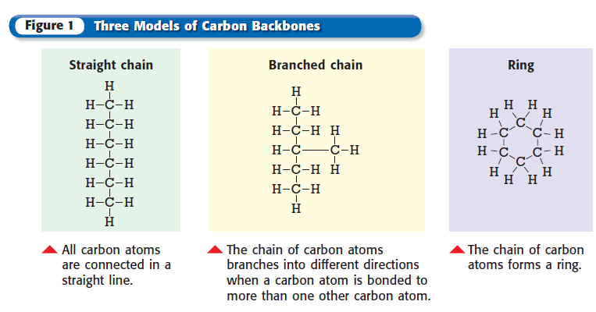
15.4 Carbon Backbones

Slide 38
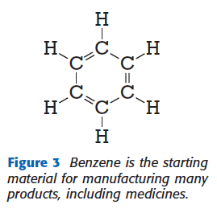
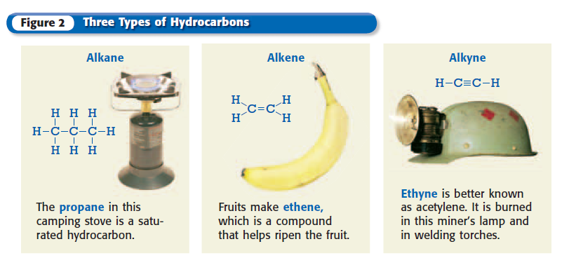
Hydrocarbons = organic compounds with only C and H
Saturated hydrocarbon: each C has 4 single bonds
Unsaturated hydrocarbon: double or triple bond
Aromatic hydrocarbon: based on benzene

Slide 39
15.4 Biochemicals
Carbohydrates: food (sugars)
Lipids: fats, oils, waxes (stores energy)
Proteins: most cell molecules are proteins
Nucleic Acids: (genes) instructions to build proteins

Slide 40
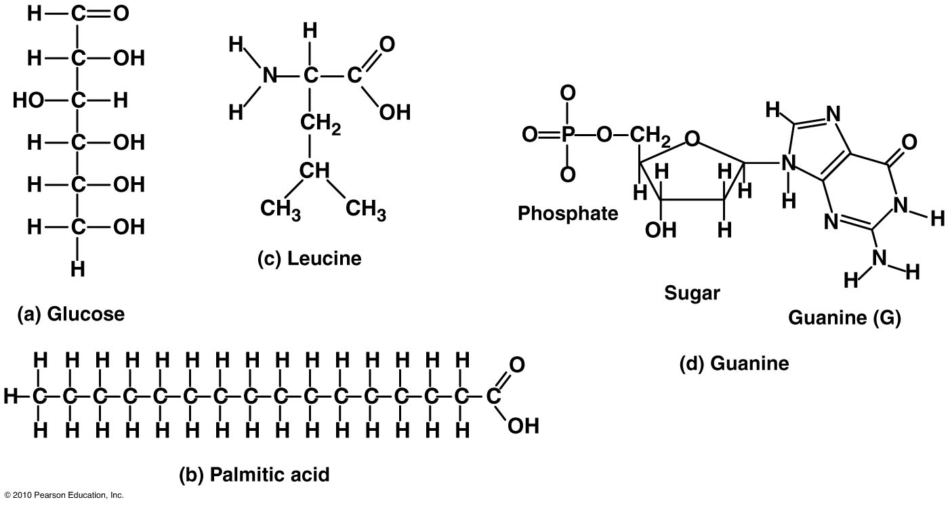
Amino acid
carbohydrate
Nitrogenous base
Lipid. Notice like soap

Slide 41
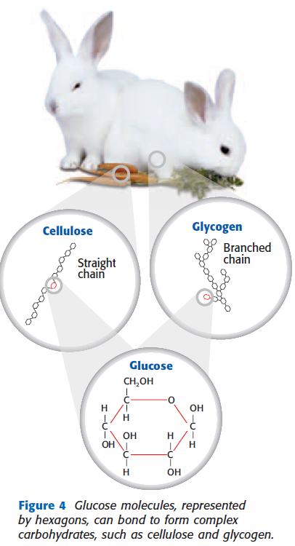
15.4 Biochemicals
Carbohydrates
Sugars (food for energy)
glucose,
Cellulose (plant cell walls). Glycogen (energy to muscle cells)

Slide 42
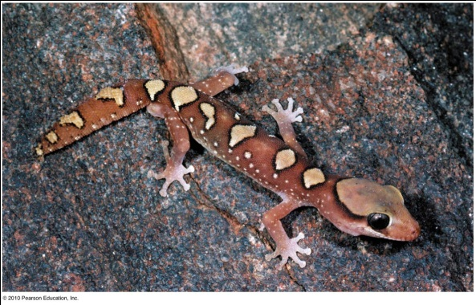
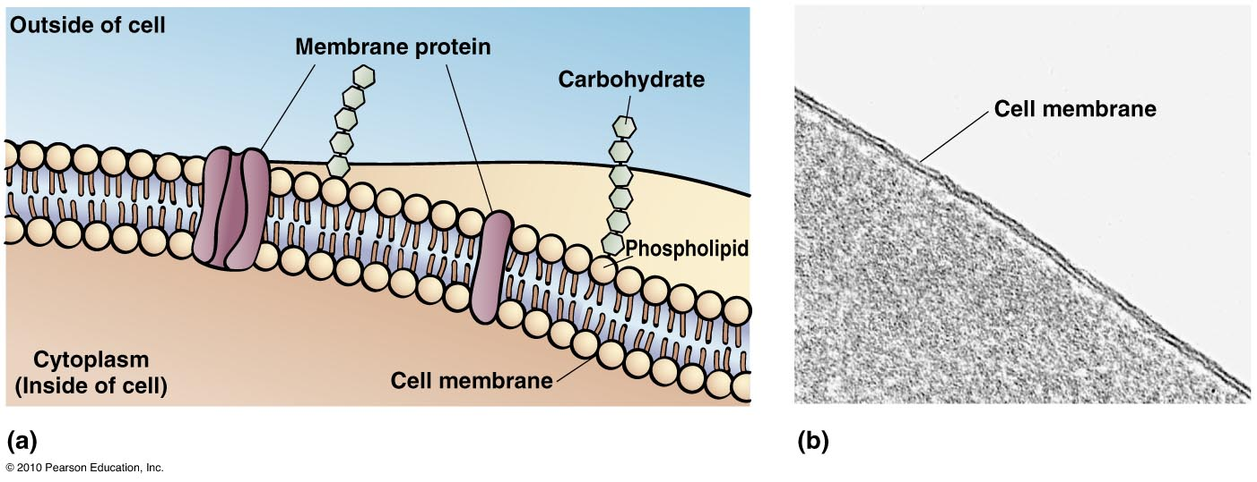
15.4 Biochemicals
Lipids
Fats, oils, waxes (stores energy efficiently)
Cell membrane

Slide 43
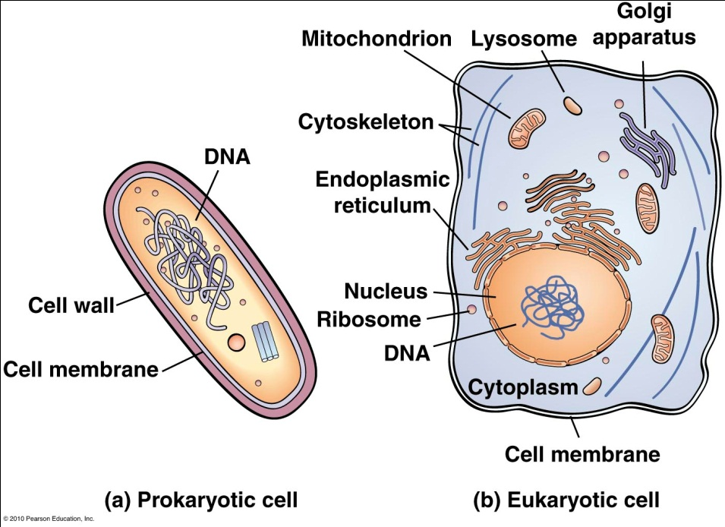
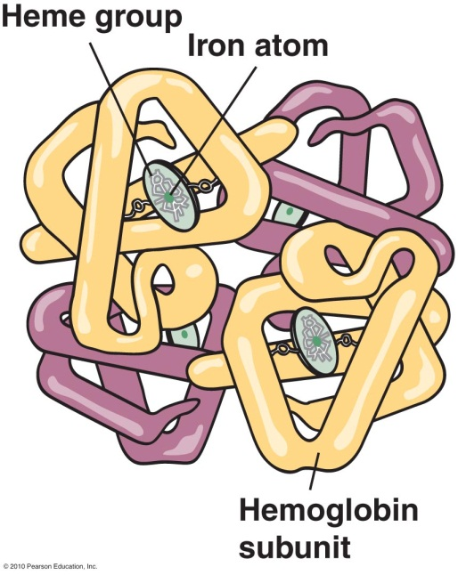
15.4 Biochemicals
Proteins
Folded strings of amino acids
Amino acid = H, O, N, S
“gates” to cell membrane
Enzymes (catalysts), hormones, hemoglobin, hair structure
Only 20 amino acids are found in living things. (we can’t make 8. eat)

Slide 44
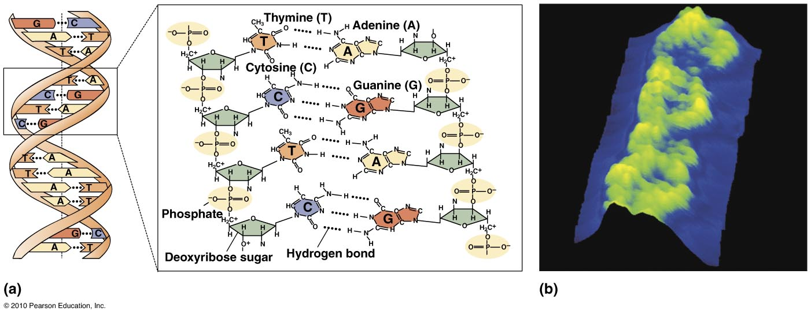
15.4 Biochemicals
Nucleic Acids: (genes) instructions to build proteins
DNA (deoxyribonucleic acid)
RNA (ribonucleic acid)
Nucleotides: molecules of C, H, O, N, P

Slide 45
Another Kind of Reaction: Redox
Oxidation-reduction

Slide 46
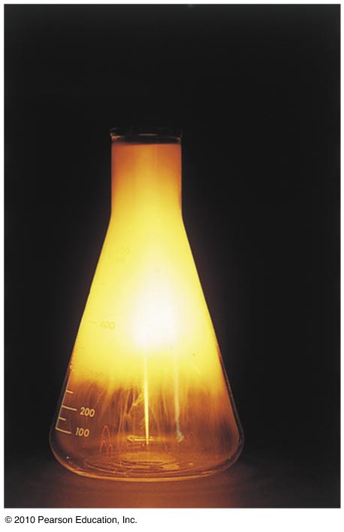
20.4 Oxidation- Reduction Reaction
http://www.youtube.com/watch?v=Mx5JJWI2aaw
Why was the water necessary?
What group is sodium in?
http://www.youtube.com/watch?v=YvSkXd_VVYk
Notes:
Salt is? NaCl. Form by? Na + Cl. Balance it: 2Na + Cl2 → 2 NaCl. Oxidation: see pg. 420

Slide 47
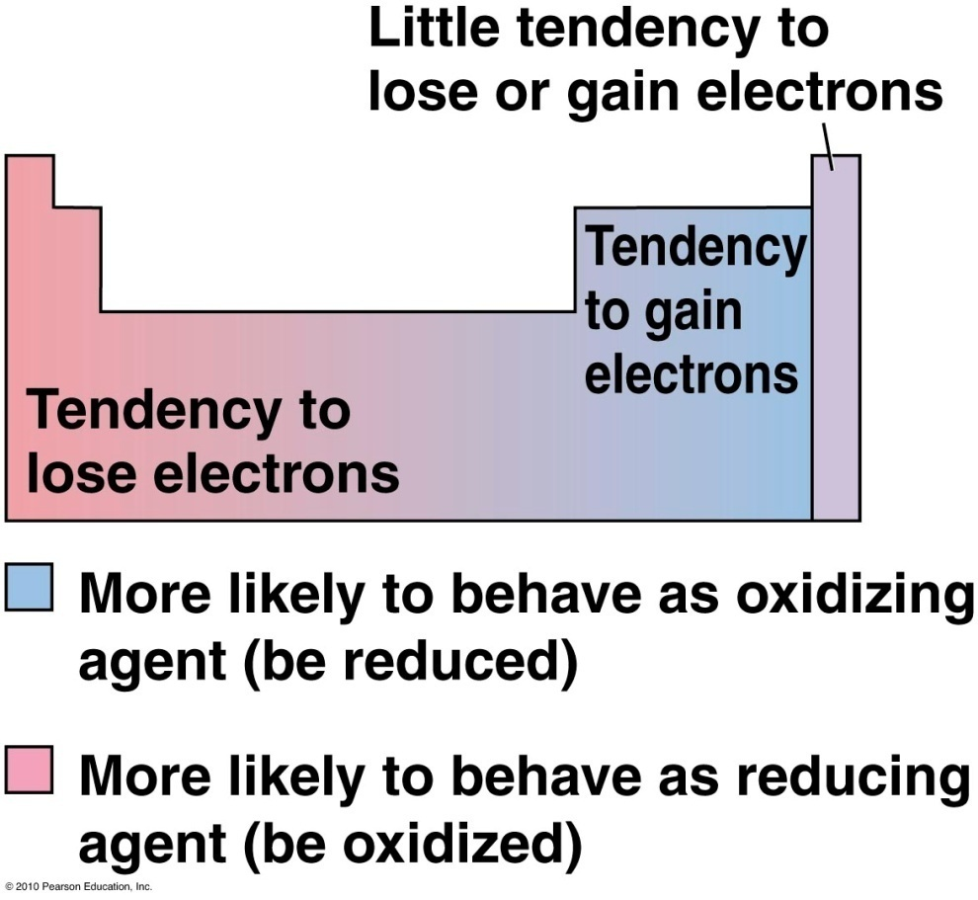
20.4 Oxidation- Reduction Reaction

Slide 48
20.4 Oxidation- Reduction Reaction
True or false?
Reducing agents are oxidized in oxidation-reduction reactions.
Oxidizing agents are reduced in oxidation-reduction reactions.

Slide 49
20.5 Electrochemistry
Oxidation-reduction reactions
Electrochemistry
Electrolysis: purifying things
Electroplating
Batteries
Oxygen
Corrosion (metal + oxygen)
Combustion (nonmetal + oxygen)

Slide 50
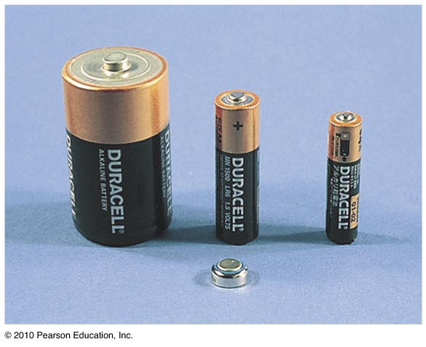
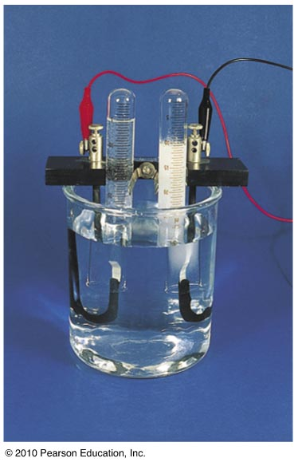
20.5 Electrochemistry
Oxidation-reduction reactions
Chemicals → electricity
Example?
Electricity → chemicals (electrolysis)
DEMO # 3
DEMO # 4

Slide 51
Demo #3

Slide 52
20.5 Electrochemistry
Electrolysis – recharge a car battery
Another example: Figure 20.23
Spark + 2H₂O → 2H₂ + O₂

Slide 53
Electrolysis
Electroplating
Purifying aluminum (efficient way discovered 1884)
Year | Price per pound
1855 1885 -- 100 1890 -- 2 1990 – 0.74 | $100,000. Napolean’s dinnerware

Slide 54
Demo #4

Slide 55
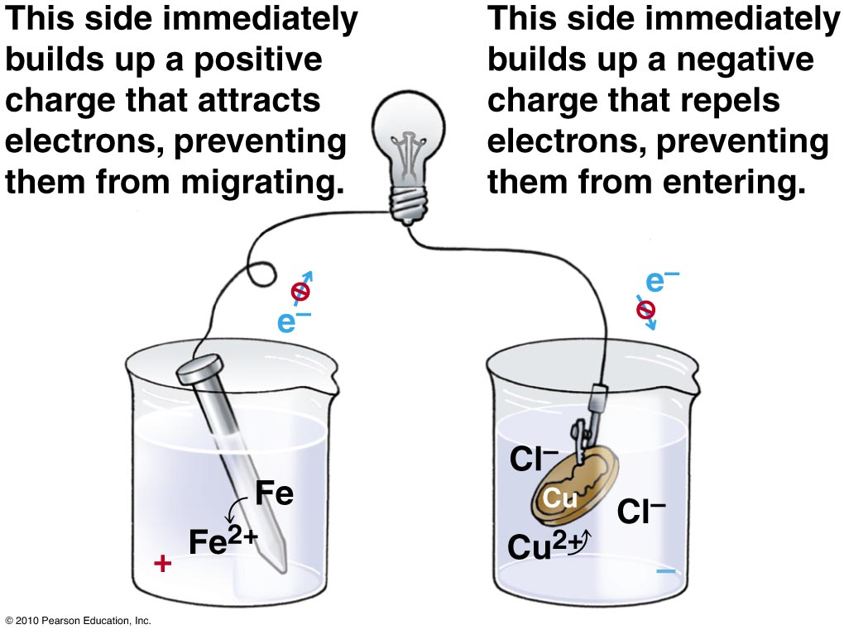
20.5 Electrochemistry

Slide 56
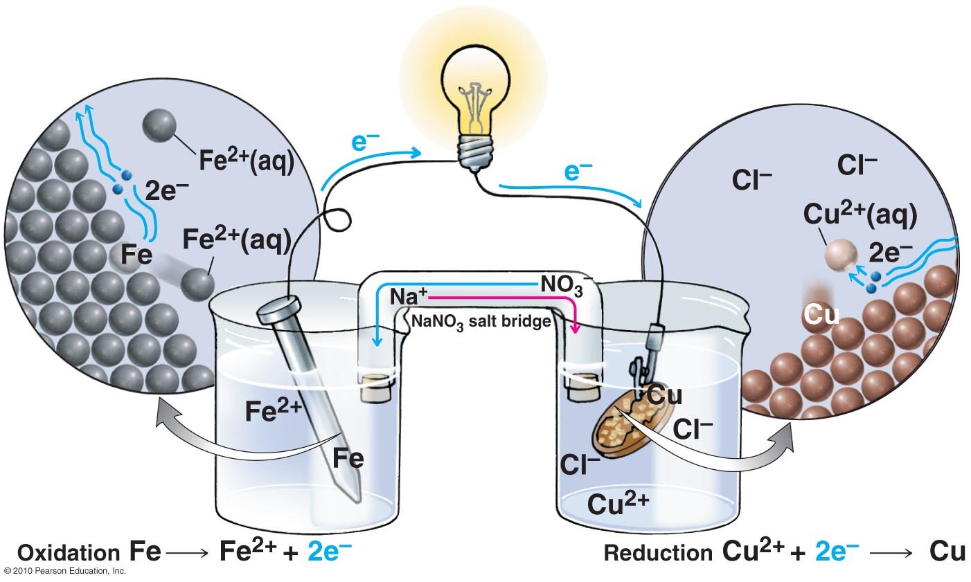
20.5 Electrochemistry

Slide 57
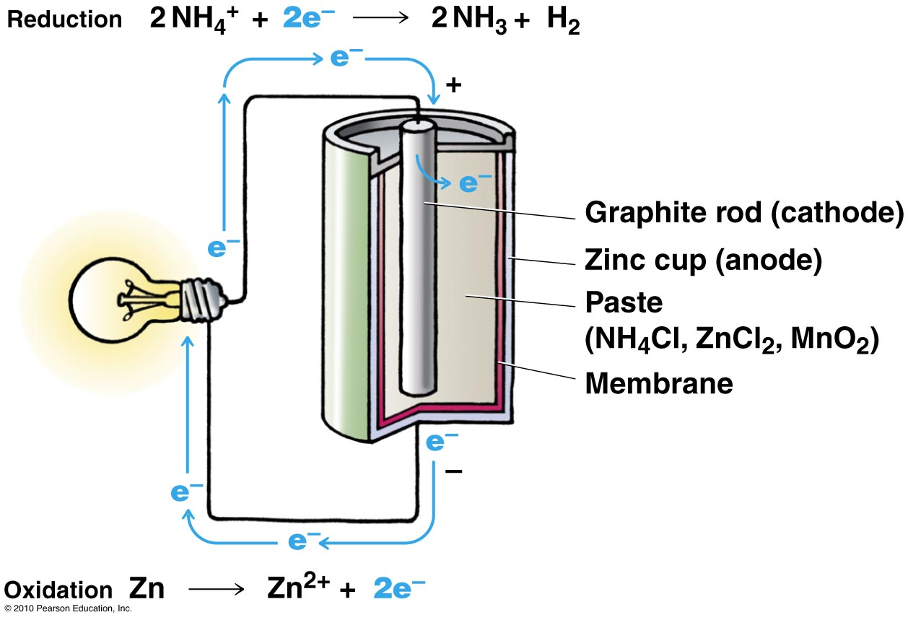
20.5 Electrochemistry

Slide 58
20.5 Electrochemistry
Alkaline battery: zinc as source of electrons
Alkaline paste
Lithium metal as source of electrons
Battery: involves
2 materials oxidize-reduce each other
They are connected by a path for ions to balance the electron flow.

Slide 59
Oxidation-Reduction

Slide 60
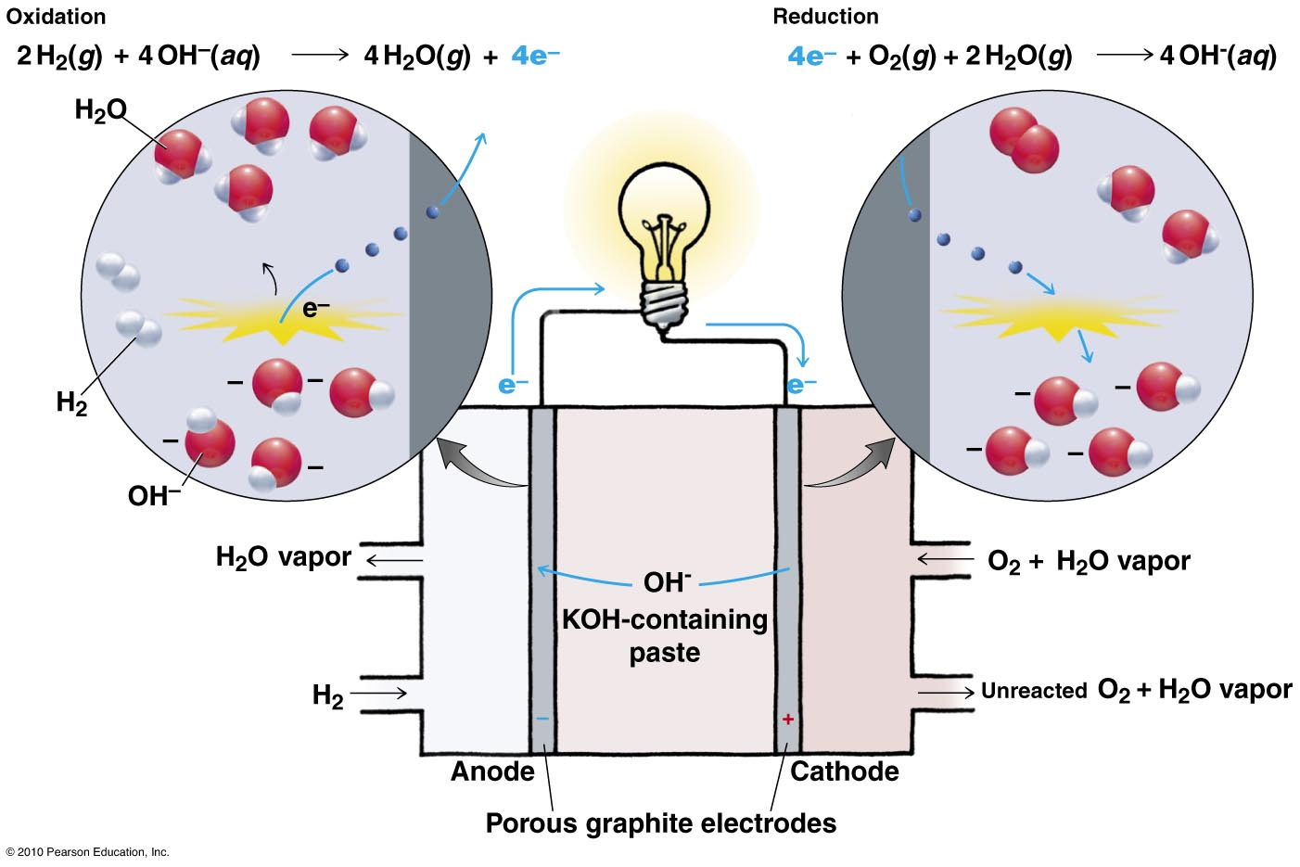
20.5 Electrochemistry: Fuel cell (Fig. 20.21)

Slide 61
20.5 Electrochemistry: Fuel cell (Fig. 20.21)

Slide 62
20.5 Electrochemistry: Fuel cell (Fig. 20.21)
Used in space shuttles for electricity. Also provides water.

Slide 63
20.6 Corrosion and Combustion
Oxygen is the most common oxidizing agent (oxygen reduces)
Oxygen plucks electrons from lower left elements
2 common oxidation-reduction reactions
Corrosion: metal deteriorates (with oxygen)
Combustion: nonmetal + oxygen → water + CO₂ + energy

Slide 64
20.6 Corrosion: an oxidation-reduction reaction
Metal deteriorates
Iron + oxygen + water → rust
4Fe + 3O₂ + 3H₂O → 2Fe₂O₃ · 3H₂O

Slide 65
20.6 Corrosion : an oxidation-reduction reaction
Rust - not harmful
loss of iron - harmful.

Slide 66
20.6 Corrosion : an oxidation-reduction reaction
Aluminum is easily oxidized by oxygen → Al₂O₃
Aluminum oxide
Waterproof layer
Shield prevents more oxidation
Galvanization – make a protective, water-proof oxidized coat
Iron coated with Zinc

Slide 67
20.6 Combustion : an oxidation-reduction reaction
Nonmetal reacts with oxygen
Exothermic reaction
Nonmetal + oxygen → water + CO₂ + energy
CH₄ + 2O₂ → 2H₂O + CO₂ + energy

Slide 68
20.6 Combustion : an oxidation-reduction reaction
Hydrogen + oxygen → violent reaction
Rocket launch
Wood & fossil-fuel (carbon-based) → CO₂ + water + energy

Slide 69
20.6 Combustion : an oxidation-reduction reaction
Methane + oxygen → carbon dioxide + water + energy

Slide 70
20.6 Combustion : an oxidation-reduction reaction
Electrons transfer
Polar covalent bonds ←→ non-polar covalent bonds
“combustion” occurs in food
Food + O₂ → CO₂ + H₂O + energy
(like methane) (breathed) (exhaled) (warmth)

